Slide 1
How?
Functional describtion of the ADCS.

Slide 2
01
Detection
How is the CubeSat oriented?

Slide 3
Two vectors:
Sun Vector
Geomagnetic Vector
The vector poionting to the sun
The vector of geo-magnetic field.

Slide 4
Two Frames of referance:
Local Frame
Global Frame
Any frame that is fixed to the CubeSat.
Any frame that fixed to the earth or the stars.

Slide 5
Rotation Matrix
defines how one frame is oriented with respect to another frame.
translates one vector from one frame to the other.
To find it, we need two pairs of vectors.
The rotation matrix is the output of the detecion phase.

Slide 6
Models
Our way to global vectors!

Slide 7
Sun Vector Model
We can mathematically model the relative motion between sun and earth.
If we know time and date, we can calculate the sun vector in earth’s frame..
So, we give the time, it gives the global sun vector.

Slide 8
Geomagnetic Vector Model
We can mathematically model the geomagnetic field.
If we know time and position, we can calculate the geomagnetic vector in earth’s frame..
So, we give the time and position, it gives the global sun vector.

Slide 9
Position?
Fairy tale of the good TLE and SGP!

Slide 10
—Me and Newton
“If you know your position and spead at the present, you can predict where you will be at the future.”

Slide 11
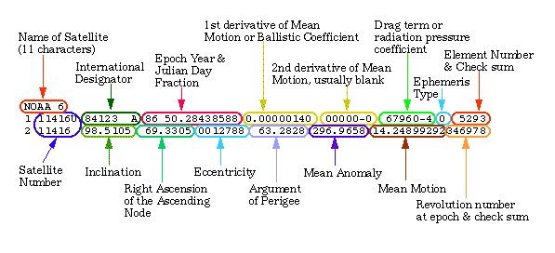
TLE Frame

Slide 12
02
Control
How to make a difference?

Slide 13
Actuators
Reaction wheal
Magnetic torquer

